Slide 1

Sales Predictive Analytics CHUA KEE SIONG (RICK) CAPSTONE AI & MACHINE LEARNING DEVELOPER PROJECT

Slide 2
Problem Statement
Predict a categorical outcome of "Sales" versus "Industry", "Product Name", "Opportunity Type", "Amount", "Opportunity Quantity", "Discount Granted", "Customer Count", "Account Type", "Billing Region", "Stage". Validate the model. Report model based on performance metric of accuracy, precision, recall and F1 score.
Goal:
Build a machine learning model to predict Sales through related Categorical feature of importances

Slide 3
System architecture & design
DATA CLEANING
& PREPARATION
EXPLORATORY DATA ANALYSIS (EDA)
ML Model Building
Deployment
DATA CLEANING & PREPARATION
EXPLORATORY DATA ANALYSIS (EDA)
ML Model Building
Deployment and Monitoring
Lessons learned
Summary
Conclusion
Challenge and Lession Learned
References
About Us

Slide 4
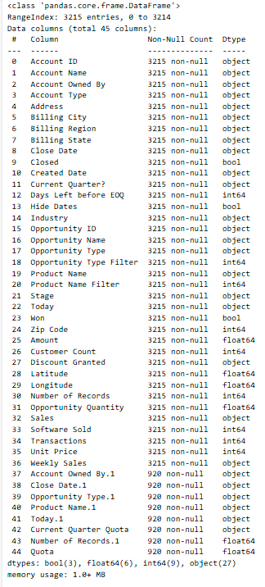
Data Cleaning and Preparation | Description
Data Loading: salesforce data.csv file was loaded into a Pandas Data Frame | Create Data Frame
Data Cleaning & prep | # Drop redundant columns (columns with '.1' suffix)df = df.drop(columns=[col for col in df.columns if col.endswith('.1')], axis=1)
Convert date columns to datetime objects | date_cols = ['Close Date', 'Created Date', 'Today']for col in date_cols: df[col] = pd.to_datetime(df[col], errors='coerce')
Clean and convert monetary and percentage columns to numeric # 'Sales' and 'Weekly Sales' columns contain '$' and 'K' characters, so remove them and convert to float | df['Sales'] = df['Sales'].replace({r'[$,]': '', 'K': 'e3', 'M': 'e6'}, regex=True).astype(float)df['Weekly Sales'] = df['Weekly Sales'].replace({r'[$,]': ''}, regex=True).astype(float)
'Current Quarter Quota' column contains '$' and 'M' characters, so remove them and convert to float | df['Current Quarter Quota'] = df['Current Quarter Quota'].replace({r'[$,]': '', 'M': 'e6'}, regex=True).astype(float)
'Discount Granted' column contains '%' character, so remove it and divide by 100 to get a float | df['Discount Granted'] = df['Discount Granted'].str.replace('%', '', regex=False).astype(float) / 100
# Convert boolean columns to integers (0 or 1) | df['Closed'] = df['Closed'].astype(int)df['Won'] = df['Won'].astype(int)
DATA CLEANING
& PREPARATION

Slide 5
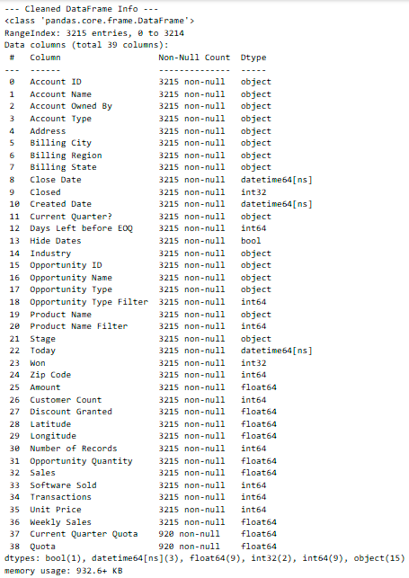
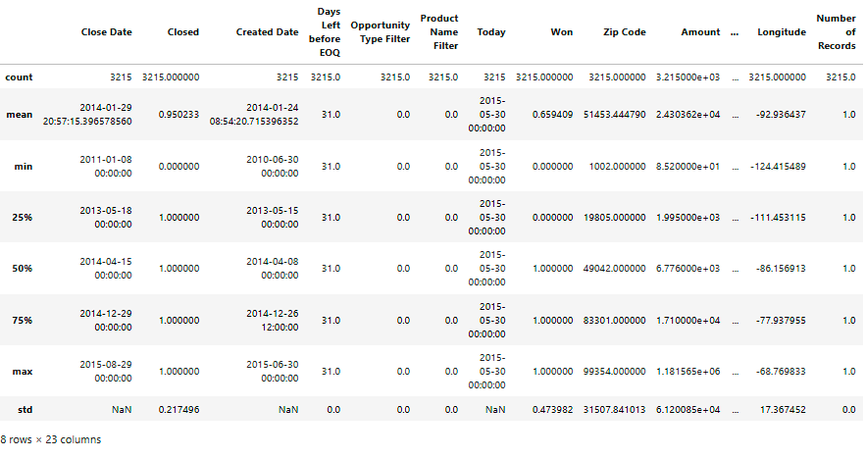
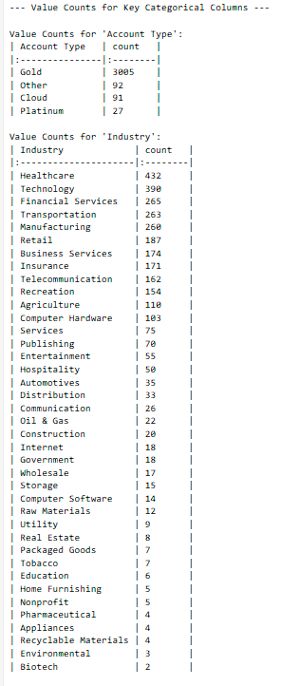
Data Cleaning and Preparation | Description
# Display basic information about the cleaned DataFrame | print("--- Cleaned DataFrame Info ---") df.info()
# Display descriptive statistics for numerical columns | print("\n--- Descriptive Statistics for Numerical Columns ---")print(df.describe().to_markdown(numalign="left", stralign="left"))
# Identify categorical columns | categorical_cols = df.select_dtypes(include='object').columns
# Display value counts for key categorical columns | print("\n--- Value Counts for Key Categorical Columns ---")for col in ['Account Type', 'Industry', 'Opportunity Type', 'Stage', 'Current Quarter?']: if col in categorical_cols: print(f"\nValue Counts for '{col}':") print(df[col].value_counts().to_markdown(numalign="left", stralign="left"))
DATA CLEANING
& PREPARATION

Slide 6
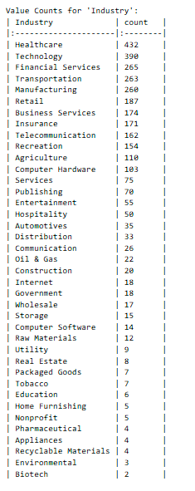
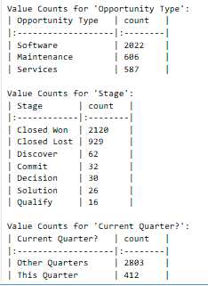
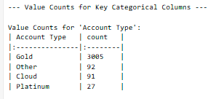
Data Cleaning and Preparation | Description
# Identify categorical columns | categorical_cols = df.select_dtypes(include='object').columns
# Display value counts for key categorical columns | print("\n--- Value Counts for Key Categorical Columns ---")for col in ['Account Type', 'Industry', 'Opportunity Type', 'Stage', 'Current Quarter?']: if col in categorical_cols: print(f"\nValue Counts for '{col}':") print(df[col].value_counts().to_markdown(numalign="left", stralign="left"))
DATA CLEANING
& PREPARATION

Slide 7
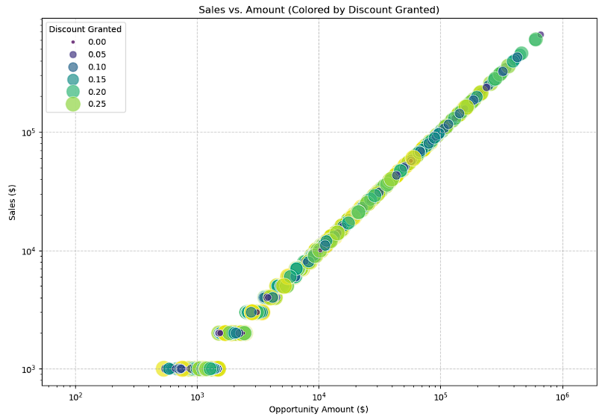
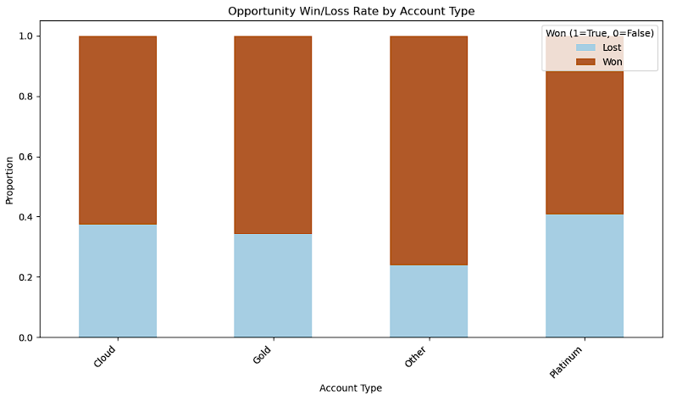
Exploratory Data Analysis (EDA) | Description
Sales vs Amount | Sales value often very close to initial opportunity amount indicate good forecast accuracy
Opportunity Win/Lost Rate | Indicate more is won over cloud/Gold and platinum Account type (0.4 to 0.3)
EXPLORATORY DATA ANALYSIS (EDA)

Slide 8
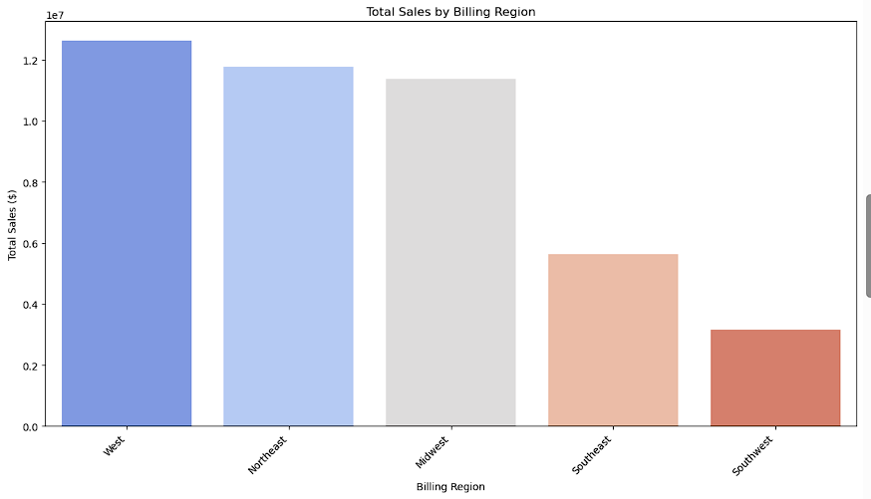
Exploratory Data Analysis (EDA) | Description
Total Sales Billing Region | Indicates top three sales region namely, West, Northeast and Midwest above 1.1 to 1.2
EXPLORATORY DATA ANALYSIS (EDA)

Slide 9
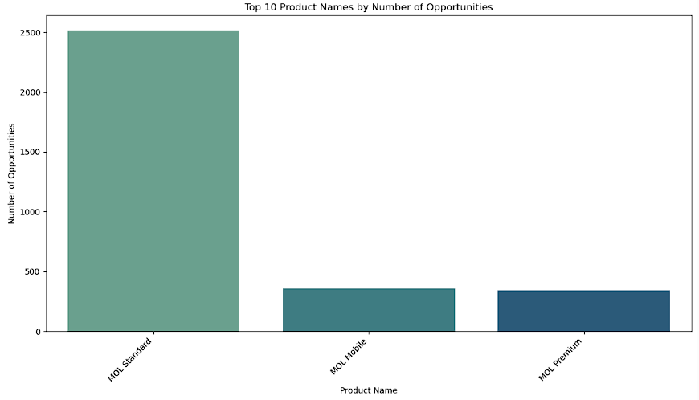
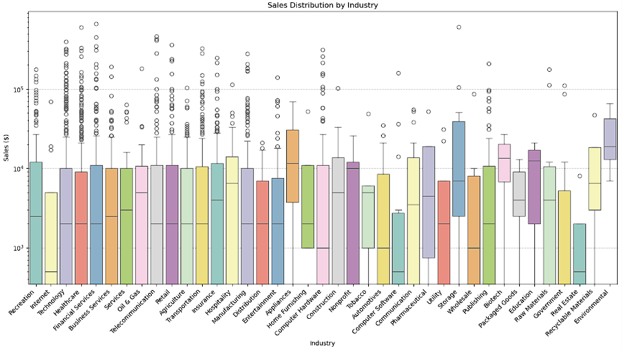
Exploratory Data Analysis (EDA) | Description
Opportunity inventory | MOL product carries Highest 2500 Opportunities indicate growth potential
Sales Distribution | High outliers at Technology,Healthcare, Financial Services, Telecommunication Industries and long tails -> high value deals potential
EXPLORATORY DATA ANALYSIS (EDA)

Slide 10
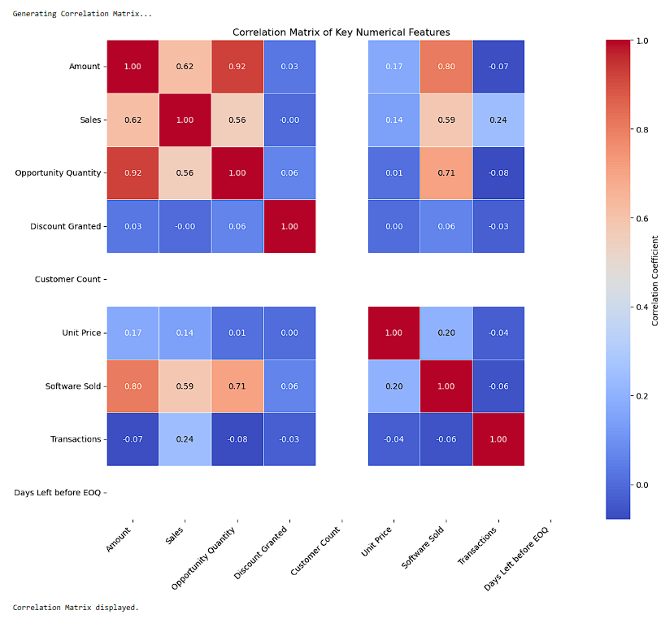
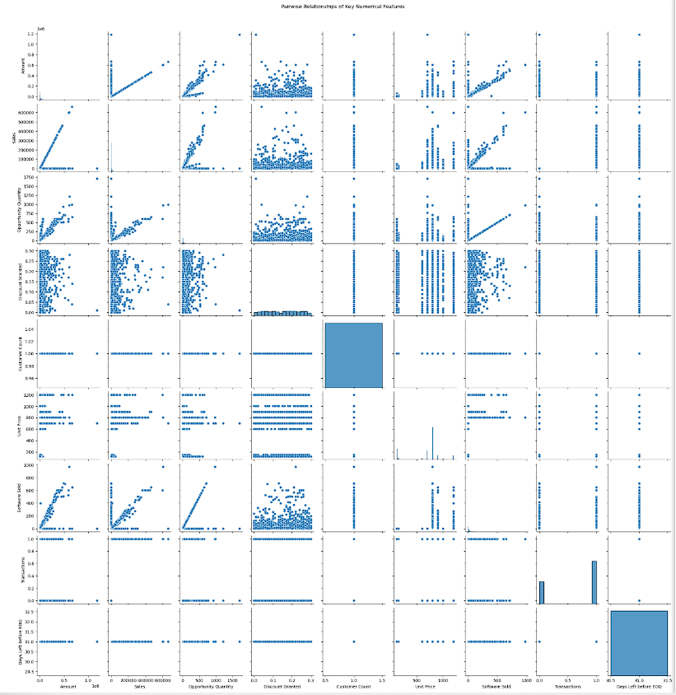
EXPLORATORY DATA ANALYSIS (EDA)
Correlation matrix / Pairplot provide a comprehensive visualization overview of the linear relationships and distributions of key numerical features. They confirm that Amount and Sales are heavily intertwined, and Opportunity Quantity is a primary driver of sales value. This EDA reinforces the importance of carefully selecting features for predictive modeling to avoid data leakage and build truly insightful models.

Slide 11
EXPLORATORY DATA ANALYSIS (EDA)
EDA Key Takeaways
Top 10 Product Names by Number of Opportunities:
"MOL Standard" is a flagship product or a common component in many deals. Understanding its sales cycle, customer satisfaction, and cross-selling potential with other products is crucial. For other products, evaluate if their lower frequency is due to market demand or less focused sales efforts.
Sales Distribution by Industry:
Focus sales and marketing efforts on industries that consistently yield high-value opportunities. Identify the characteristics of high-value deals within these industries to optimize sales strategies. For industries with lower average sales, consider volume-based strategies or re-evaluating the effort-to-return ratio.

Slide 12
EDA Key Takeaways
Sales vs. Amount (discount granted):
Sales Team close deal close to their original opportunity amount.
Discount apply did not alter amount in large scale. Further investigate
On high-discount could reveal impact on profitability
Opportunity Win/Loss Rate by Account Type:
Strategic focus on "Gold" and "Platinum" accounts is paying off in terms of win rates. Consider analyzing the sales strategies or challenges specific to "Silver" and "Bronze" accounts to improve their win rates, or re-evaluate the effort allocation if these tiers are less profitable.
Total Sales By Billing Region:
The "West" region is a primary revenue driver. Investigate the success factors in the "West" (e.g., market density, sales team strength, specific industries) and consider replicating successful strategies in underperforming regions. Resource allocation and sales targets might need to be adjusted based on regional performance.
EXPLORATORY DATA ANALYSIS (EDA)

Slide 13
Machine Learning Models
Choices for evaluation
Choices of models for evaluation: Random Forest Regressor Gradient Boosting Regressor (e.g XGBoost, LightGBM) Linear Regression Support Vector Regressor (SVR) K-Nearest Neighbors (KNN) Regressor
From these 5 models, choose the best model based on performance metric of accuracy, precision, recall and F1 score.

Slide 14
Machine Learning Models
Choices for evaluation
Choices of models for evaluation Logistic Regression(LR) K-Nearest Neighbors(KNN) Random Fores(RF) Decision Tree(DT) Support Vector Machine(SVM)
From these 5 models, choose the best model based on performance metric of accuracy, precision, recall and F1 score.

Slide 15
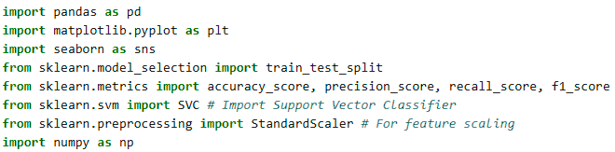
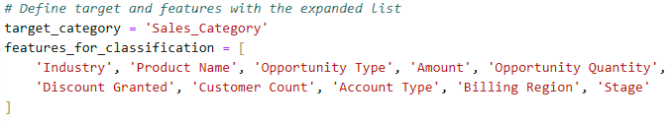
Machine Learning Code Flow (1/4)
Import data libraries
1. #Categorize 'Sales' into 'Low Sales' and 'High Sales' based on median
2. # Define target and features with the expanded list
ML Model Building

Slide 16



Machine Learning Code Flow (2/4)
# Filter DataFrame to include only the relevant columns for this analysis
# Handle missing values in the selected features# Identify numerical and # categorical features in the selected subset
# Impute numerical missing values with the median
# Impute categorical missing values with the mode
# Drop rows where the target variable itself might be missing
ML Model Building

Slide 17

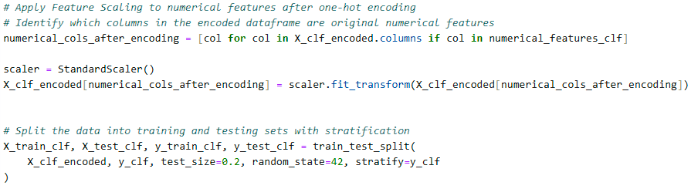
Machine Learning Code Flow (3/4)
# Separate features (X_clf) and target (y_clf)
# Apply One-Hot Encoding to categorical features
# Apply Feature Scaling to numerical features after one-hot encoding # Identify which columns in the encoded dataframe are original numerical features # Split the data into training and testing sets with stratification
ML Model Building

Slide 18
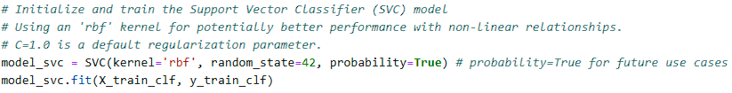

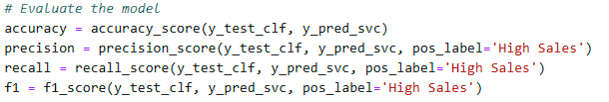
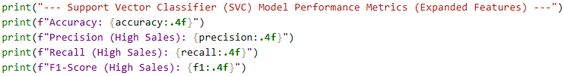
Machine Learning Code Flow 4/4)
# Initialize and train the Support Vector Classifier (SVC) model# Using an 'rbf' kernel for potentially better performance with non-linear relationships.# C=1.0 is a default regularization parameter.
# Make predictions on the test set
# Evaluate the model
# Print Model Evaluation Metrics
ML Model Building

Slide 19
Best Model Performance Metric
Model Performance Comparison | Accuracy | Precision | Recall | F1 Score | Comments
Random Forest Regressor | 1.00 | 1.00 | 1.00 | 1.00 | Overfitting. Not Adopted
Gradient Boosting Regressor (LightGBM) | 1.00 | 1.00 | 1.00 | 1.00 | Overfitting. Not Adopted
Logistic Regression model | 0.8818 | 0.8217 | 0.961 | 0.8859 | Include Evaluation list
Support Vector Regressor (SVR) | 0.8958 | 0.8315 | 0.981 | 0.8999 | Include Evaluation list
K-Nearest Neighbors (KNN) Regressor | 0.8227 | 0.7781 | 0.88 | 0.8257 | Include Evaluation list

Slide 20
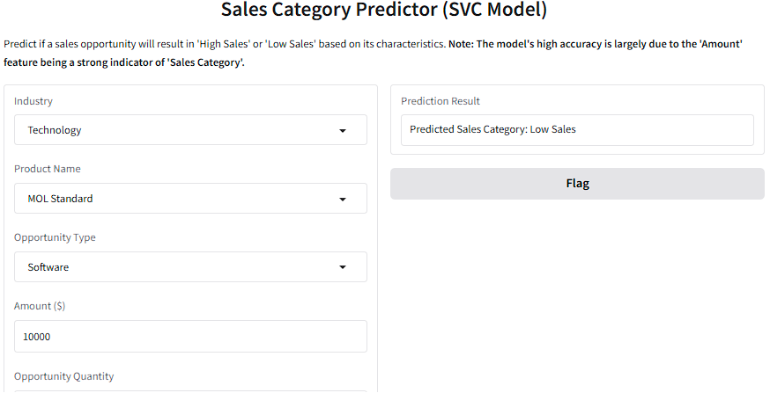
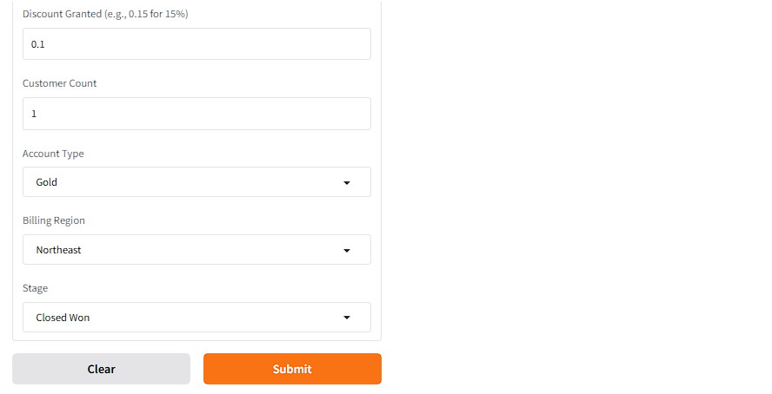
Deployment
SVM ML model Deployed with Gradio Interface
Test successful based on Sales Category input
Continuous improvement by monthly and quarterly model-retrain

Slide 21
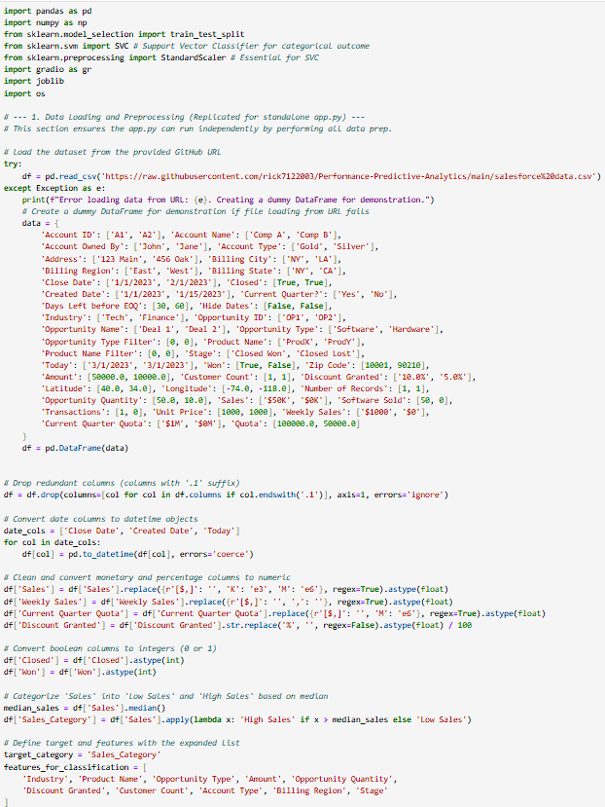
Deployment
SVM ML model code Snippets

Slide 22
Conclusion
Support Vector Regressor (SVR) ML Model appeared to be the best model among the tested 5 machine learning models
Model results Analysis:
The Accuracy has dramatically increased to approximately 89.58%, which is a substantial improvement over previous models that used a limited feature set (e.g., 50-60% accuracy). This indicates that the model is now much better at correctly classifying sales as 'High Sales' or 'Low Sales’. The Precision for 'High Sales' is 83.15%, meaning that when the model predicts 'High Sales', it is correct over 83% of the time. The Recall for 'High Sales' is exceptionally high at 98.05%. This signifies that the model is highly effective at identifying nearly all actual 'High Sales' opportunities. This is particularly valuable if the business goal is to ensure that very few 'High Sales' opportunities are missed. The F1-Score of 0.8999 reflects a strong balance between precision and recall for the 'High Sales' class, indicating robust overall performance.
The model avoided overfitting and position itself as the more suitable model to adopt for sales prediction tasks

Slide 23
Challenges and Lesson Learnt
Area | Challenges | In-Depth Lessons Learned & Best Practices
Data Prep and cleaning | Raw data is messy, missing, mixture of values, and need data feature engineering for modelling | Time need to impact data Prep, clean, EDA, identify data of feature importance
Feature Engineering | Hard to identify, require test to find few critical features of importance | Adopt simple model first and advance to complex ones to get best results
Model Selection | At first difficult, need research, trail and error to get the best suitable ML model | Use model validation and accuracy metric test to get best results
Deployment | Steep learning curve to adopt appropriate interface to simulate ML model adoption usage | Basics of gradio and coding
Tuning Hyperparameters | Can be difficult and complex, ambiguity to get better results | Use smaller dataset to test results Once pilot test is successful, adopt a similar but larger dataset

Slide 24
Future and Considerations
Feature selection to exclude importances features that has least impact
Further hyperparameters tuning to get better performance without sacrificing accuracy metrics
To conduct regular model re-train and fine tune the process
Integrate Salesforce data live into the SVM ML model and align with sales management objectives to boost sales growth

Slide 25
References
Dataset Source
https://www.kaggle.com/datasets/rahuldhanola/salesforce-sales-quota-data?resource=download
https://github.com/rick7122003/Performance-Predictive-Analytics
https://www.linkedin.com/in/chua-kee-siong-rick-01772544/

Slide 26
About us
The CAPSTONE AL and ML Developer project is to showcase the capabilities of ML to model, train, deploy world live sales dataset to boost corporate goals in sales revenue optimization and growth as overall business objectives

